Slide 1
School of Information Technology
ICT302
Information Technology Professional Practice Project
ITP3
Project Scope Management

Slide 2
Acknowledgement
of Country
We acknowledge that Murdoch University is situated on the lands of the Whadjuk and Binjareb Noongar people.
We pay our respect to their enduring and dynamic culture and the leadership of Noongar elders past and present.
The boodjar (country) on which Murdoch University is located has for thousands of years, been a place of learning. We at Murdoch University are proud to continue this long tradition.
Notes:
South Street
We acknowledge that Murdoch University is situated on the lands of the Whadjuk and Binjareb Noongar people.
We pay our respect to their enduring and dynamic culture and the leadership of Noongar elders past and present.
The boodjar (country) on which Murdoch University is located has for thousands of years, been a place of learning. We at Murdoch University are proud to continue this long tradition.

Slide 3
Learning Objectives
Understand the importance of good project scope management
Explain the scope definition process and describe the contents of a project scope statement
Discuss the process for creating a Work Breakdown Structure (WBS) using the analogy, top-down, bottom-up, and mind-mapping approaches

Slide 4
Learning Objectives
Explain the importance of verifying scope and how it relates to defining and controlling scope
Understand the importance of controlling scope and approaches for preventing scope-related problems in information technology projects
Describe how software can assist in project scope management

Slide 5
What is PROJECT SCOPE?
PROJECT SCOPE is the overall or total work to be performed in order to meet the client’s requirements or expectations of the project
This includes the work involved in creating the products of the project, and the processes used to create them
It necessarily implies identifying the boundaries of the work for the project, by determining what tasks will be included in the project and those that will not be included

Slide 6
What is PROJECT SCOPE?
PROJECT SCOPE is defined by the project scope statement
In this unit the Requirements and Analysis document (R&A) – and in particular (the functional and non-functional requirements) – serves to define PROJECT SCOPE

Slide 7
What is Project Scope Management?
Project scope management refers to the processes involved in defining the PROJECT SCOPE, and managing and controlling the performance of all tasks identified (i.e. those needed to successfully complete the project, within the PROJECT SCOPE)
This includes the breakdown of all tasks needed to successfully complete the project, which is typically achieved by representing all tasks in the Work Breakdown Structure (WBS); this involves a hierarchical decomposition of all tasks until only atomic tasks remain

Slide 8
What is Project Scope Management?
Project scope management ensures that all stakeholders have the same understanding of what the products of the project will produce, and what processes the project team will use to produce them
It also ensures that, for the duration of the project, only those tasks defined by the PROJECT SCOPE are undertaken, and that those outside the PROJECT SCOPE are not undertaken

Slide 9
Importance of the Scope
All the stakeholders must have the same understanding of the scope and deliverables
Scope may be the basis for contractual (and/or legal) obligations
Scope is clearly related to the project’s requirements
Requirements are the set of features and functions that characterize the product or service

Slide 10
Minimum Viable Product
A minimum viable product, or MVP, is a product with enough features to attract early-adopter customers and validate a product idea early in the product development cycle.
Your project deliverable is constrained in time and experience
Discuss with your client and supervisor what features etc your MVP should have and quality standards it should meet.

Slide 11
Project Scope Management Processes
Planning Scope: Creating a project scope management plan that documents how the project scope will be defined, verified, controlled, and how the work breakdown structure (WBS) will be created and defined.
Collecting requirements: defining and documenting the features and functions of the products to be produced during the project as well as the processes used for creating them
Defining scope: reviewing the project charter, requirements documents, and organizational process assets to create a scope statement
Creating Work Breakdown Structure (WBS): subdividing the major project deliverables into smaller, more manageable components
Verifying scope: formalizing acceptance of the project deliverables
Controlling scope: controlling changes to project scope throughout the life of the project

Slide 12
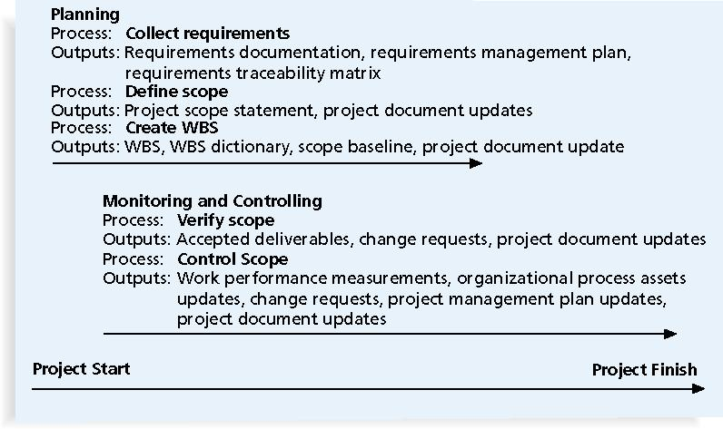
Project Scope Management

Slide 13
Collecting Requirements
A requirement is:
“A condition or capability that must be met or possessed by a system, product, service, result, or component to satisfy a contract, standard, specification, or the formal document” (PMBOK® Guide, 2008)

Slide 14
Defining Scope
Key inputs for preparing the project scope
statement include:
The project charter
Requirements documentation
Organizational process assets such as policies and procedures related to scope statements as well as project files and lessons learned from previous projects
As time progresses, the scope of a project should become clearer and more specific

Slide 15
Scope Definition
A scope statement should include:
A description of the project including:
Overall objectives and justifications
Detailed description of project requirements
Characteristics and requirements of the product
Specific success criteria
Scope boundaries, constraints, assumptions, milestones
For this unit, much of the information for the scope statement is obtained from the Requirements and Analysis Document.

Slide 16
Attributes of a Scope Definition
A good scope statement:
Improves time, cost and resource estimation
Defines a baseline for project control and performance measurement
Aids in communication

Slide 17
Creating the Work Breakdown Structure (WBS)
A WBS is a deliverable-oriented grouping of the work involved in a project that encompasses the total scope of the project
WBS is a foundation document that provides the basis for planning and managing project schedules, costs, resources, and changes
Decomposition is subdividing project tasks or deliverables into smaller pieces
A work package is a task at the lowest level of the WBS (Atomic)

Slide 18
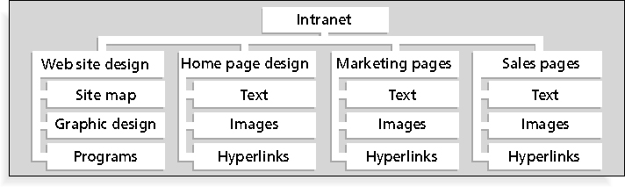
Sample Intranet WBS Organized by Product

Slide 19
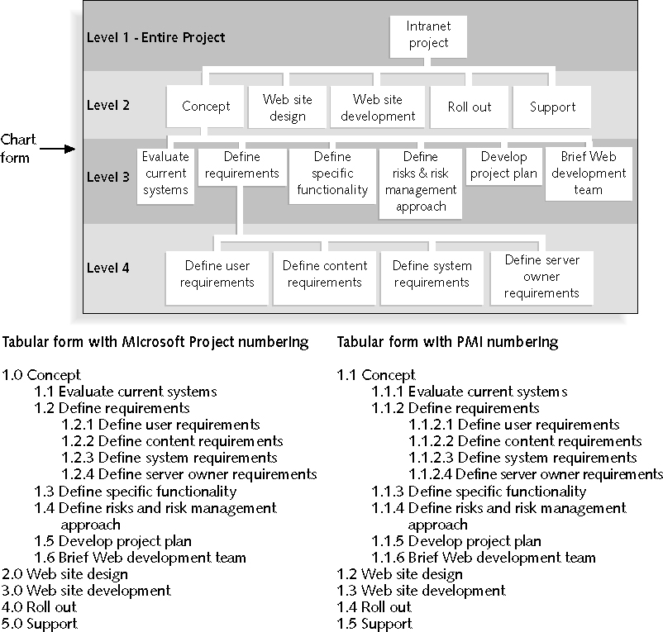
Sample Intranet WBS Organized by Phase

Slide 20
Sample WBS: as a Table
1.0 Concept
1.1 Evaluate current systems
1.2 Define requirements
1.2.1 Define user requirements
1.2.2 Define content requirements
1.2.3 Define system requirements
1.2.4 Define server owner requirements
1.3 Define specific functionality
1.4 Define risks and risk management approach
1.5 Develop project plan
1.6 Brief Web development team
2.0 Web Site Design
3.0 Web Site Development
4.0 Roll Out
5.0 Support
Notes:
20

Slide 21
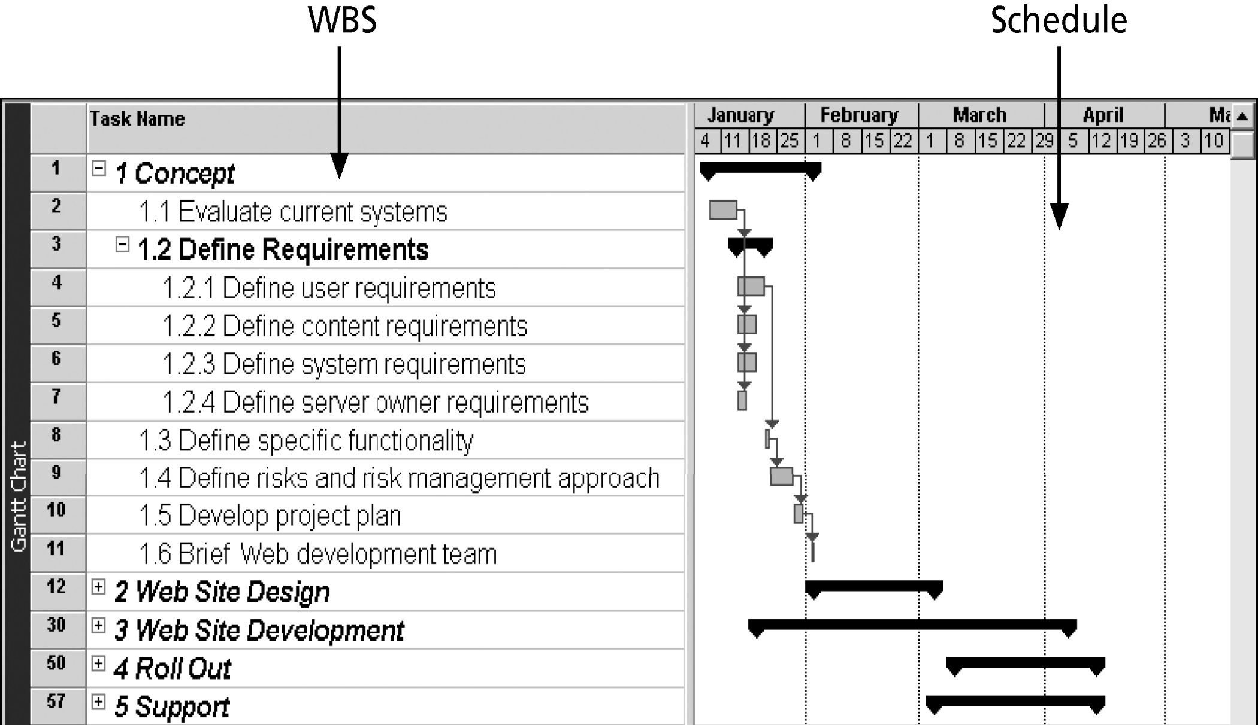
Intranet WBS and Gantt Chart in Microsoft Project

Slide 22
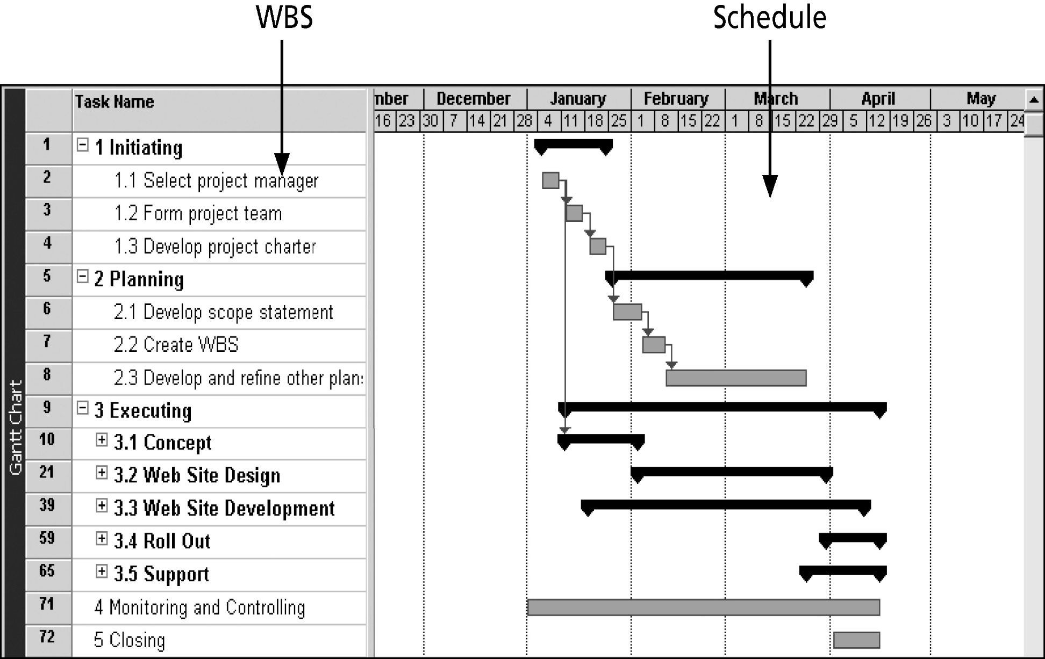
Intranet Gantt Chart Organized by
Project Management Process Groups

Slide 23
Approaches to Developing WBSs
Using guidelines: many large organizations provide guidelines for preparing WBSs
The analogy approach: review WBSs of similar projects and tailor to your project
The top-down approach: start with the largest items of the project and break them down
The bottom-up approach: start with the specific tasks/work packages and roll them up
The mind-mapping approach: mind mapping is a technique that uses branches radiating out
from a core idea to structure thoughts and ideas

Slide 24
The WBS Dictionary and
Scope Baseline
Many WBS tasks/work packages are vague and must be explained more so people know what to do and can estimate how long it will take and what it will cost to do the work
A WBS dictionary is a document that describes detailed information about each WBS work package
The approved project scope statement and its WBS and dictionary form the Scope baseline, which is used to measure* performance in meeting project scope goals
* Remember if you cannot measure something it becomes intangible, therefore difficult to describe and demonstrate completeness!

Slide 25
Advice for Creating a WBS and WBS Dictionary
A work package should appear at only one place in the WBS
The work content of a WBS work package is the sum of the WBS work packages below it
A WBS work package is the responsibility of only one individual, even though many people may be working on it
The WBS must be consistent with the way in which work is actually going to be performed; it should serve the project team first and other purposes only if practical

Slide 26
Advice for Creating a WBS and WBS Dictionary
Project team members should be involved in developing the WBS to ensure consistency
Each WBS work package must be documented in a WBS dictionary to ensure accurate understanding of the scope of work included and not included in that work package
The WBS must be a flexible tool to accommodate inevitable changes while properly maintaining control of the work content in the project according to the scope statement

Slide 27
Verifying Scope
It is very difficult to create a good scope statement and WBS for a project
It is even more difficult to verify project scope and minimize scope changes
Scope verification involves formal acceptance of the completed project scope statement by the stakeholders
Acceptance is often achieved by a customer inspection and then sign-off on key deliverables

Slide 28
Controlling Scope
Scope control involves controlling changes to the project scope
Goals of scope control are to: Influence the factors that cause scope changes
Assure changes are processed according to procedures developed as part of integrated change control
Manage changes when they occur
Variance is the difference between planned and actual performance

Slide 29
Controlling Scope
Most change requests are a result of:
An external event – eg: change in government regulation
An error in defining the scope of the product
An error in defining the scope of the project
A value adding change – eg: enabling technology for design might change the design outcomes
Lead to:
Modifications and corrective action
Lessons learned
Adjusted baseline
Notes:
29

Slide 30
Best Practices for Avoiding Scope Problems
Keep the scope realistic
Don’t make projects so large that they can’t be completed
Break large projects down into a series of smaller ones
2. Involve users in project scope management
Assign key users to the project team and give them ownership of requirements definition and scope verification

Slide 31
Best Practices for Avoiding Scope Problems
3. Use off-the-shelf hardware and software whenever possible
Many IT people enjoy using the latest and greatest technology, but business needs, not technology trends, must take priority
4. Follow good project management processes
There are well-defined processes for managing project scope and other aspects of projects

Slide 32
Using Software in Project Scope Management
Word-processing software helps create scope-related documents
Spreadsheets help perform financial calculations and weighed scoring models, and help develop charts and graphs
Communication software, such as e-mail and the Web, helps clarify and communicate scope information
Project management software helps create a WBS, the basis for tasks on a Gantt chart
Specialized software is available to assist in project scope management

Slide 33
Summary
Project scope management includes the processes required to ensure that the project addresses all the work required—and only the work required—to complete the project successfully
Main processes include:
Scope planning
Scope definition
WBS creation
Scope verification
Scope control

Slide 34
Peter Cole
p.cole@Murdoch.edu.au
0417 097 914

